Slide 1
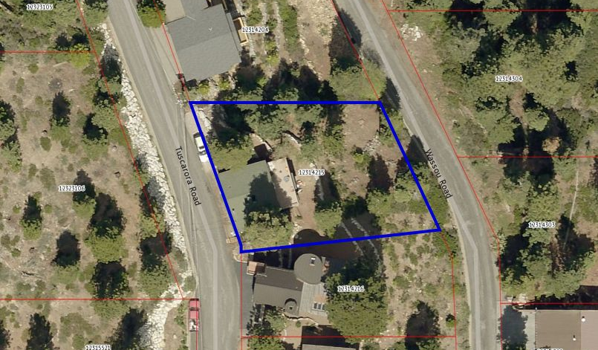
WPVAR16-0001 (Meyer-McSherry)
Washoe County Board of Adjustment
February 2, 2017

Slide 2
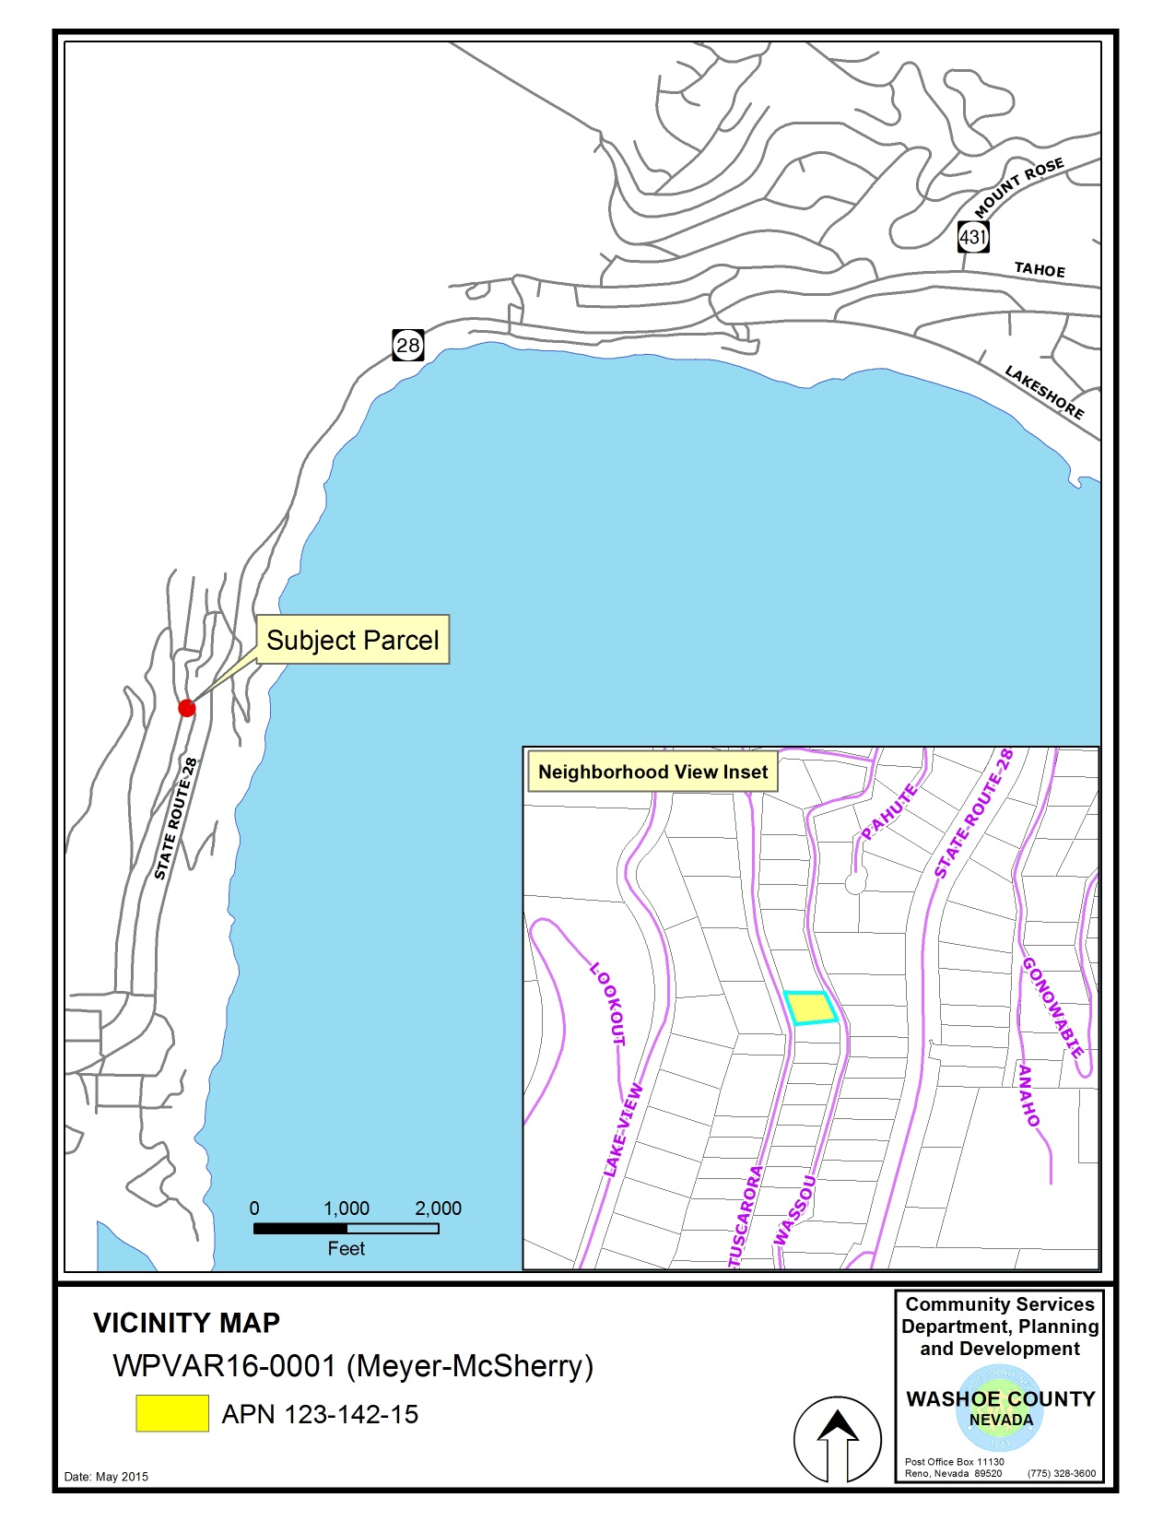
380 Tuscarora Rd
Crystal Bay

Slide 3
Background
Subject property is zoned High Density Suburban – 20/5 foot front/side yard setbacks
Requesting a reduction of the front yard setback from 20 feet to 7.1 feet; and
Reduction of side yard setback from 5 to 3.5 feet
Allow construction of a garage and an associated hallway/bridge connection to the existing house
Existing parking pad is partially in the ROW

Slide 4
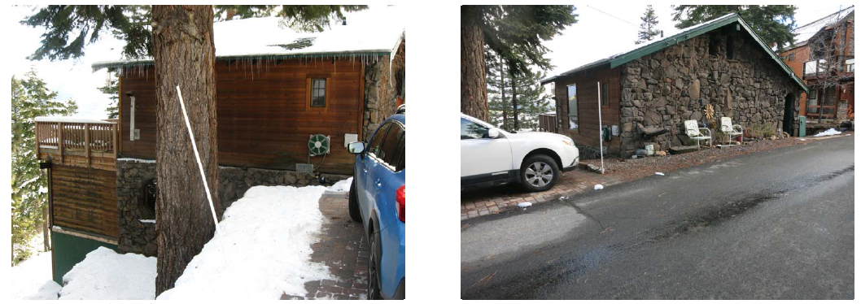
Background

Slide 5
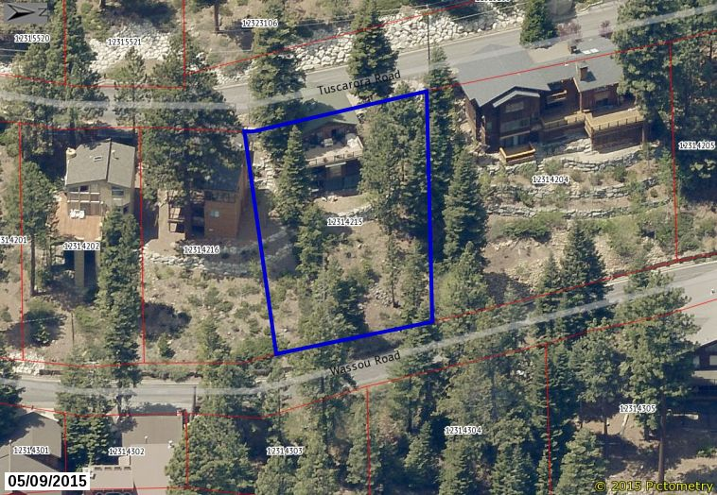
Background

Slide 6
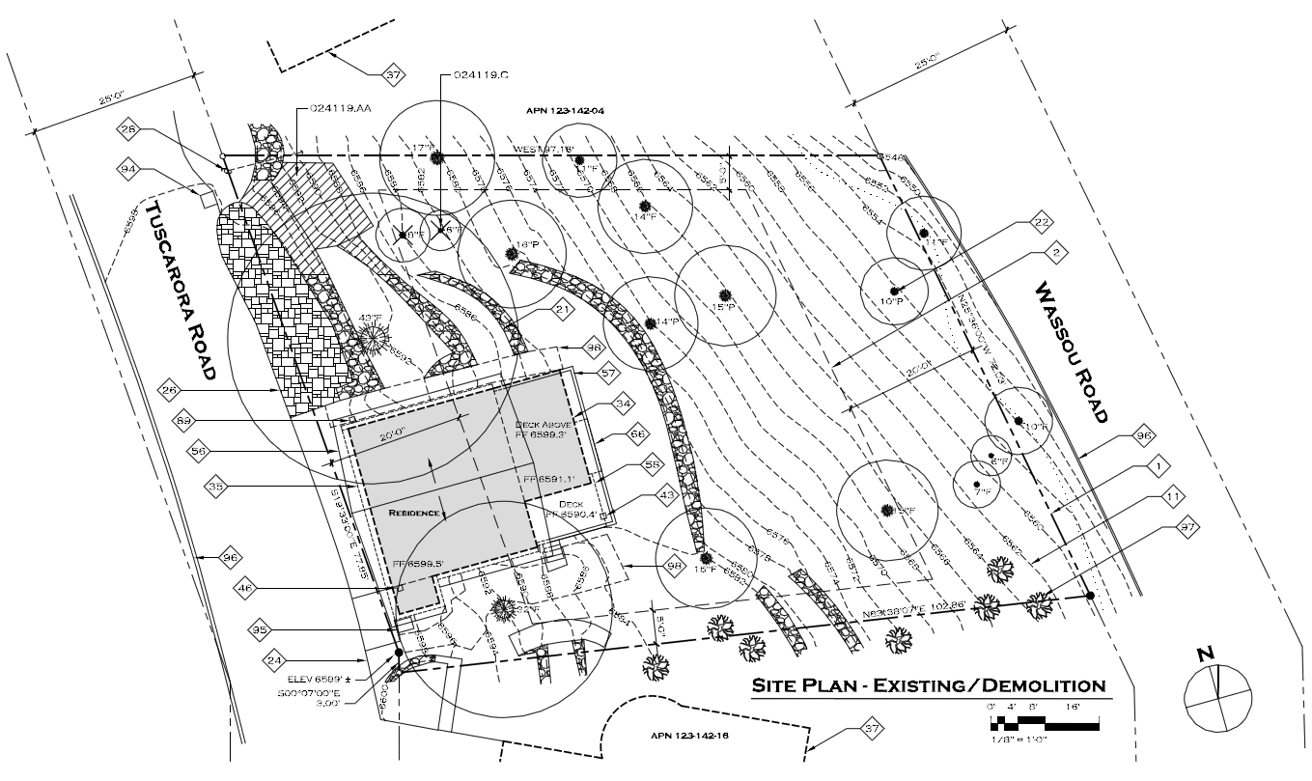
Existing Site Plan

Slide 7
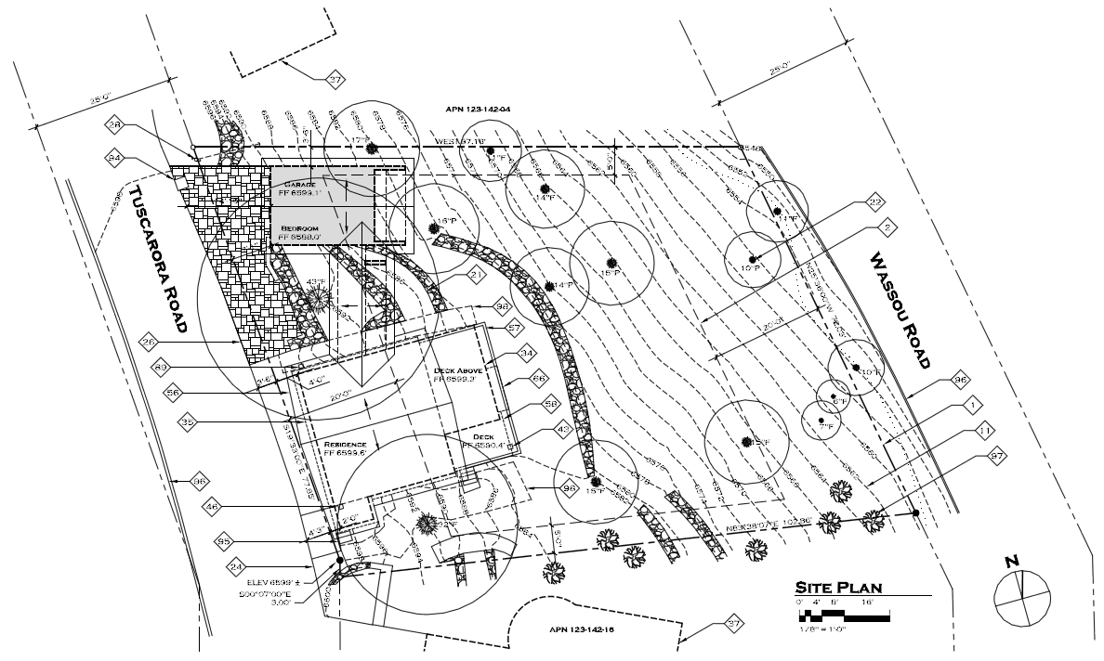
Proposed Site Plan

Slide 8
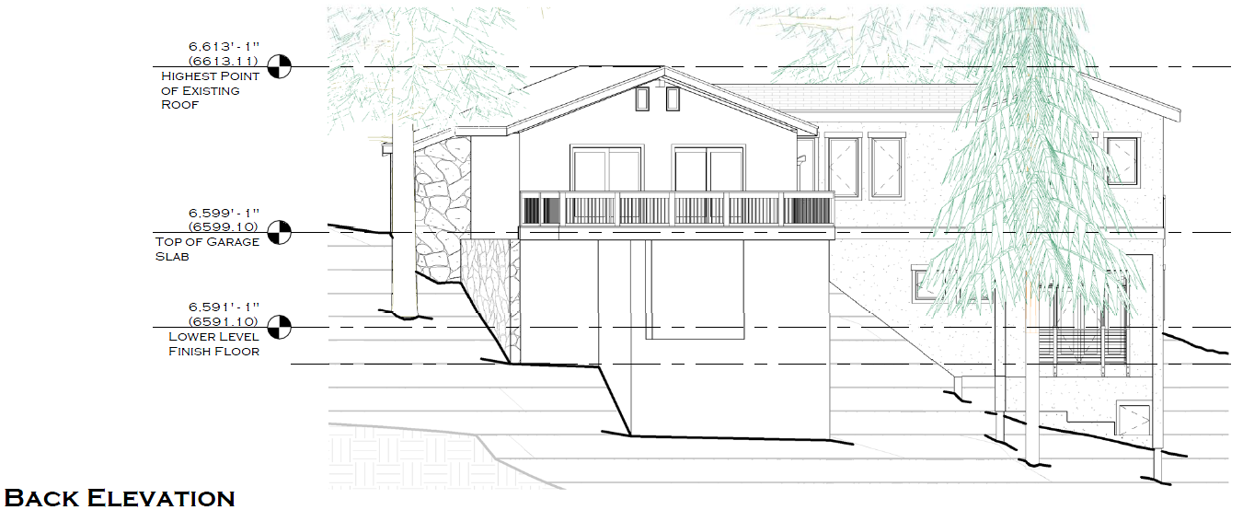
Elevations

Slide 9
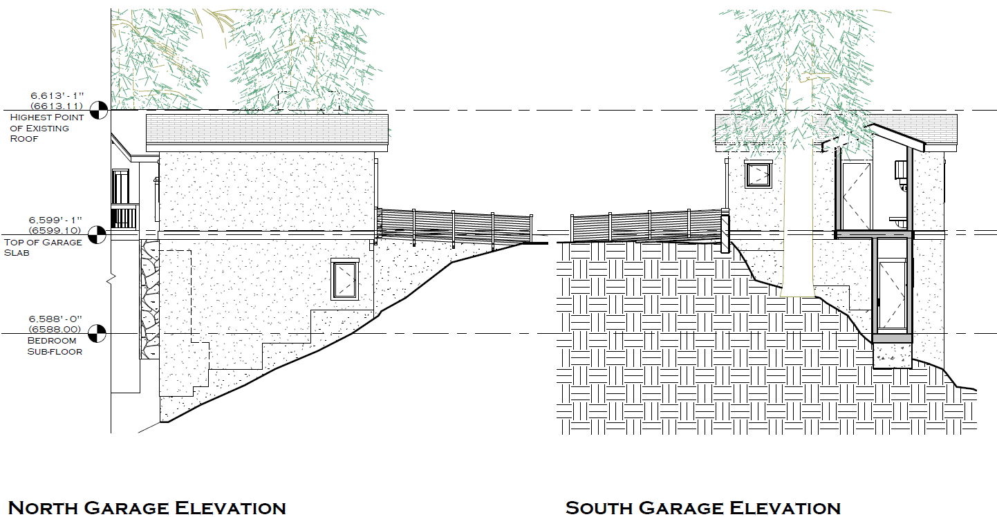
Elevations

Slide 10
Analysis
The parcel is not exceptionally narrow, but is extremely sloped (over 40% grade)
Existing 552 s.f. residence built in 1966 is already within the front yard setback (approx. 18 feet)
Currently no garage
On street parking is very limited
Most of the houses on the down sloping side of Tuscarora are built into the front yard setback

Slide 11
Analysis
Special circumstances exist (topography, tree)
No detriment to the public good:
Upslope property views
Provide off street parking
No grant of special privileges – similar adjacent properties and setback relief, exist. house
Proposed use is authorized

Slide 12
Reviewing Agencies
Washoe County Community Services Department
Planning and Development Division
Engineering and Capital Projects Division
Land Development
Roads
Traffic
North Lake Tahoe Fire Protection District
Incline Village General Improvement District
Regional Transportation Commission

Slide 13
Reviewing Agencies
3 out of the 7 reviewing agencies noticed requested conditions of approval:
Planning and Development
Engineering and Capitol Projects Division, Land Development
Engineering and Capitol Projects Division, Traffic Engineering
See Exhibit A of the staff report for the recommended conditions of approval

Slide 14
Citizen Advisory Board
The Incline Village/Crystal Bay Citizen Advisory Board does not meet in the winter and therefore did not review the application
The CAB was sent a copy of the application for comment
Staff has not received any comments from CAB members

Slide 15
Public Comment
Staff has received comments from the adjacent neighbor at 390 Tuscarora objecting to the variance (especially the side yard)
The comments were received on Monday Jan. 30th – after distribution of the staff report
Concerns include negative visual impacts, loss of privacy, maintenance and snow storage issues, safety, and alteration of drainage and slope stabilization rock walls

Slide 16
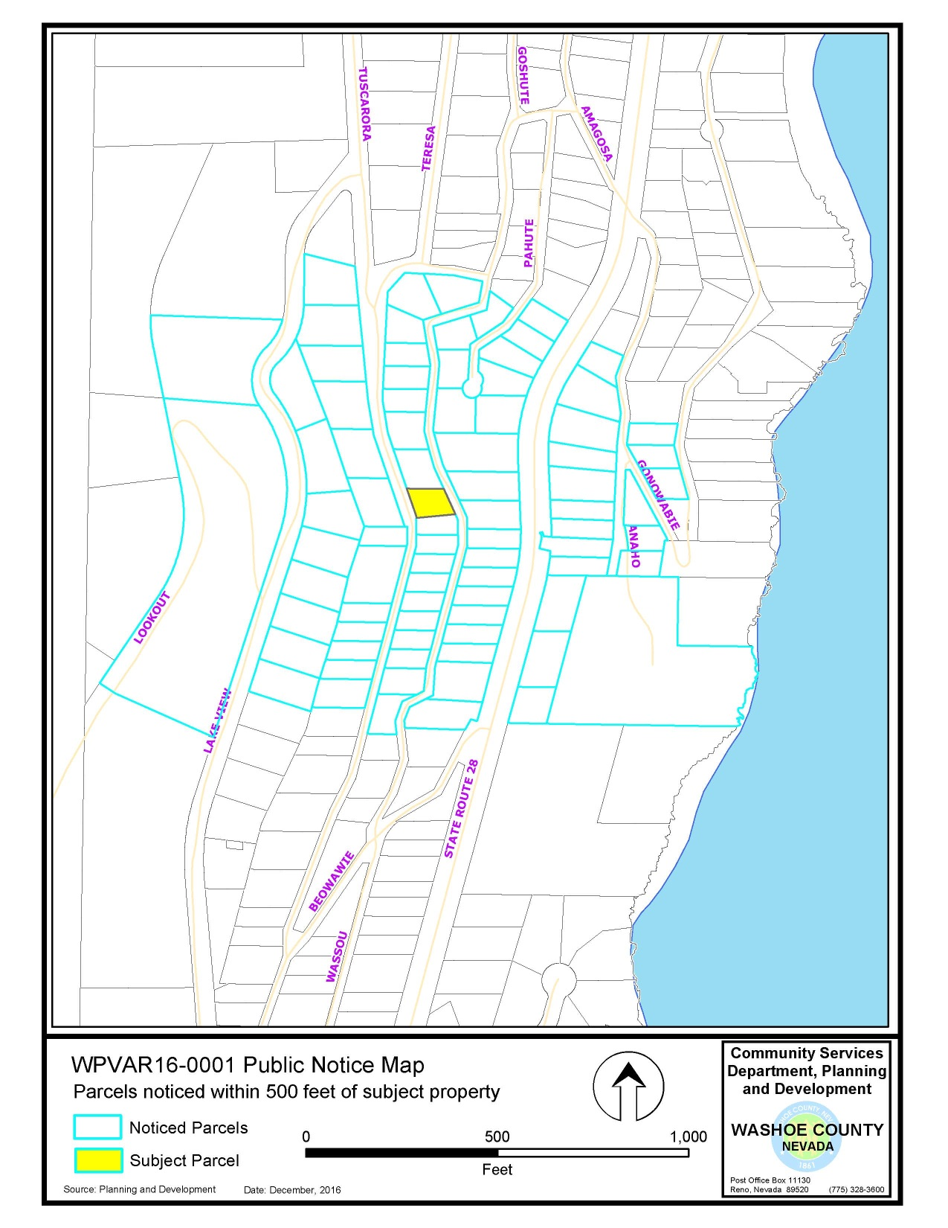

Slide 17
Required Findings
WCC Section 110.804.25, Variance Findings:
Special Circumstances (Exceptional narrowness, exceptional topography, exceptional situation)
No detriment
No special privileges
Use authorized
Effect on Military Installation

Slide 18
Required Findings
Staff analysis is provided in the staff report starting on page 9
Staff is able to make all of the required findings

Slide 19
Staff Recommendation
After a thorough analysis and review, Variance Case Number WPVAR16-0001 for Meyer-McSherry is being recommended for approval with conditions.

Slide 20
Possible Motion
I move that, after considering the information contained within the staff report and the information received during the public hearing, the Washoe County Board of Adjustment approve, with the conditions included at Exhibit A to the staff report for this item, Variance Case Number WPVAR16-0001 for Meyer-McSherry, being able to make the findings required by Washoe County Code Section 110.804.25 for approval of Variances.

Slide 21
Appeal Process
Board of Adjustment action will be effective 10 calendar days after the written decision is filed with the Secretary to the Board of Adjustment and mailed to the applicant, unless the action is appealed to the Washoe County Board of County Commissioners, in which case the outcome of the appeal shall be determined by the Washoe County Board of County Commissioners. Any appeal must be filed in writing with the Planning and Development Division within 10 calendar days after the written decision is signed by and filed with the Secretary to the Board of Adjustment, and mailed to the applicant.

